Slide 1
English Presentation on Book/movie review by group 6
Group Members:
Ragven – 016
Rahul – 021
Divya – 042
Arindam - 046
Kunal – 051
Vaibhav – 052
Thomas – 064
Abhishek – 426
Tanishq – 449
Rajveer - 450

Slide 2

TUBELIGHT
written and directed by Kabir khan
PLOT SUMMARY
Laxman, a feeble young man, has no other family except his brother, Bharat. He is heartbroken when his brother is drafted into the army after a war breaks out between India and China.
BY RAGVEN MAHTO
RA2011004010016

Slide 3

Yaavarum Nalam [13B: Fear Has a New Address]
Yaavarum Nalam was released in March 2009. It was directed by Vikram Kumar. This came out in 3 languages Hindi, Telugu and Tamil. This is a horror and thriller movie. It got the Vijay Awards for Best Editor. Movie runs for 2 hours and 15 minutes.
Manohar, along with his family, moves into a new apartment on the 13th floor. However, their peace is disturbed by a spirit that uses the television set as a medium to communicate with them.
BY Rahul
RA2011004010021

Slide 4
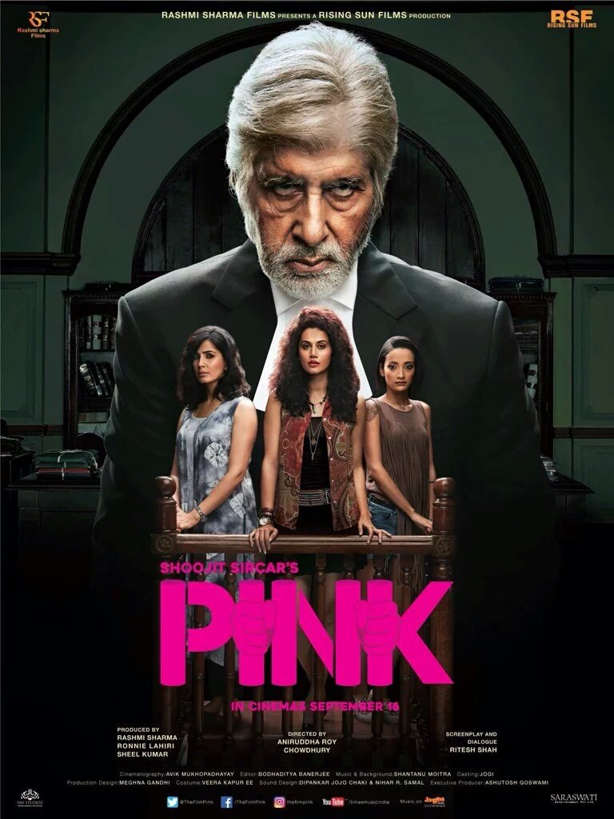
PINK
Directed : Aniruddha Roy Chowdhury
Written : Shoojit Sircar,Ritesh Shah and Aniruddha Roy Chowdhury.
Cast : Amitabh Bachchan, Taapsee Pannu, Kirti Kulhari, Andrea Tariang, Angad Bedi, Tushar Pandey, Piyush Mishra, and Dhritiman Chatterjee.
Released : 16 September 2016
Plot Summary :
After being molested, Minal, along with her friends, tries to file an FIR against a politician's nephew. When the subsequent case gets rigged, Deepak, a retired lawyer, helps them to fight the case.
Some famous dialogues:
“Hamare yahaan ghadi ki sui, character decide karti hai.”
“‘Na’ sirf ek shabd nahi… apne aap mein pura vakya hai. Ise kisi tark, spashtikaran, explanation ya vyakhya ki jaroorat nahi hoti.”
=> Divya Jha
RA2011004010042

Slide 5
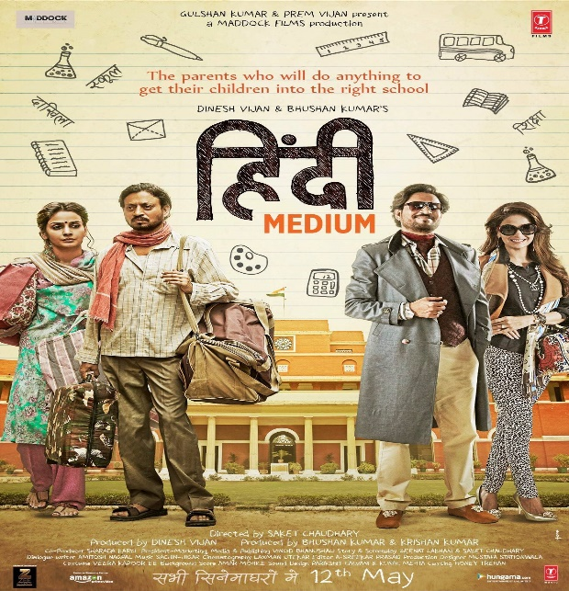
HINDI MEDIUM
Directed: Saket Chaudhary
Written: saket Chaudhary,zeenat Lakhani, amitosh nagpal(dialogues)
CAST: Irrfan khan, saba qamar,Deepak dobriyal,amrita singh
release: 19 may 2017
SUMMARY
RAJ and mita batra yearn to get pia, their daughter educated from a posh school. When they learn that their background is holding her back , they are willing to go to any lengths to change her fate
Some dialogues
“Is desh me angrezi zabaan nahi hai… class hai”
BY ARINDAM SRIVASTAVA
RA2011004010046

Slide 6


RICH DAD POOR DAD
Finding ways to make your money work for you.
Emphasize on your financial literacy.
Difference between assets and liabilities.
Learning to Invest.
Work for Learning – Don’t work for money.
Use assets to buy luxuries.
ROBERT T. KIYOSAKI
Published: 1997
Kunal Keshan
RA201100401051

Slide 7
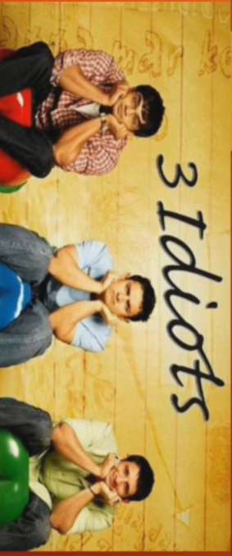
3 IDIOTS
Directed : Rajkumar Hirani
Written : Rajkumar Hirani,Abhijat Joshi
Cast : Aamir Khan, Madhavan, Sharman Joshi, Kareena Kapoor, Boman Irani, Omi Vaidya, Rahul Kumar, Amardeep Jha, Mukund Bhatt and Chaitali Bose Released : 25 December 2009
Plot Summary :
Rancho is an engineering student. His two friends. Farhan and Raju, Rancho sees the world in a different way. Rancho goes somewhere one day. And his friends find him. When Rancho is found, it becomes a one of a great scientist in the world.
All time Favorite
All Izz Well…
Some famous dialogues-
Life is a race … If you don’t run fast… you will be like a broken andaa…
Life is a race … If you don’t run fast… you will be like a broken andaa…
Kaamyaab hone ke liye nahin, Kaabil hone ke liye padho!
Badi Duvidha Thi, Dost Ko Sambhalte Ki Dost Ki Maa Ke Aasoon Pochte… Phir Humne Socha Hatao Yaar Matar Paneer Pe Concentrate Karo…
Exam toh bahut hote hai, baap mostly ek hi hota hai
BY Vaibhav
RA2011004010052

Slide 8

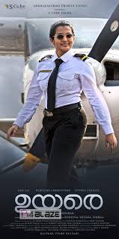
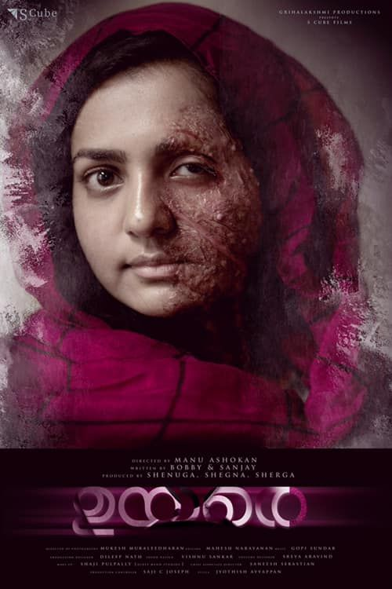
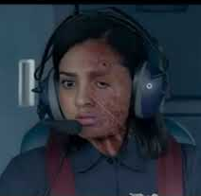
UYARE
Indian Malayalam-language family drama film directed by Manu Ashokan (in his directorial debut), written by Bobby & Sanjay and produced by the sister-trio Shenuga, Shegna, and Sherga.^{[1]} The film stars Parvathy Thiruvothu, Asif Ali and Tovino Thomas with Siddique, Anarkali Marikar and Prathap Pothen in supporting roles
Conquering the skies by becoming a pilot was Pallavi's (Parvathy Thiruvothu) life long dream. However, her dreams are shattered when she falls victim to an acid attack by her possessive and insecure lover, Govind (Asif Ali).
BY Thomas
RA2011004010064

Slide 9

Taare Zameen Par Produced by - Aamir Khan Directed by- Aamir Khan & Amole Gupte Cast: Aamir Khan as art teacher, Darsheel Safary as Ishaan Awasthi , Tanay Cheda as Rajan Damodaran (Ishaan’s friend), Sachet Engineer as Yohan Awasthi(Ishaan’s brother), Tisca Chopra as Maya Awasthi (Ishaan’s mother), Vipin Sharma as Nandkishore Awasthi (Ishaan’s father) Release date - 21 December 2007 Budget - ₹120 million , Box office - ₹889 million 8.4/10 - IMDb 91% -Rotten Tomatoes Audience rating summary – 4.9 STORYLINE: Ishaan is criticised by his parents for his poor academic performance and is sent away to a boarding school. Ram (AAMIR KHAN) an art teacher, however, realises he has dyslexia( also known as reading disorder) and helps him uncover his potential. Dialogue: 1.Duniya mein aaise aaise heere paida huye hai, jinhone sari duniya ka naksha hi badal diya… Kyun ki yeh duniya ko apni alag nazar se dekh paaye. 2. Apni ambitions ka wajan apne bachcho ke nazuk kandhon pe daalna… it’s worse than child labour 3. Bahar ek beraham competitive duniya basi hai …aur is duniya mein sabhi ko apne apne gharon mein toppers aur rankers ughaane hai 4. Every Child is Special! AWARDS: 1. The Filmfare Award for Best Film for 2008 2. The 2008 National Film Awards for the Best Film on Family Welfare 3. The 2009 Academy Awards Best Foreign Film and MORE.
By- Abhishek Kumar Raj
RA2011004010426

Slide 10
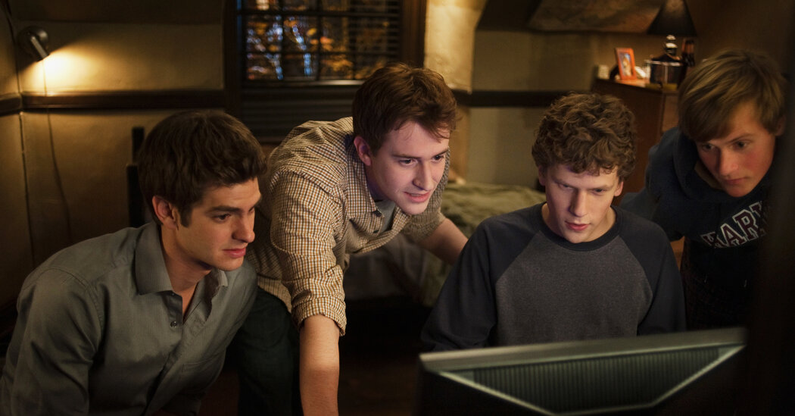
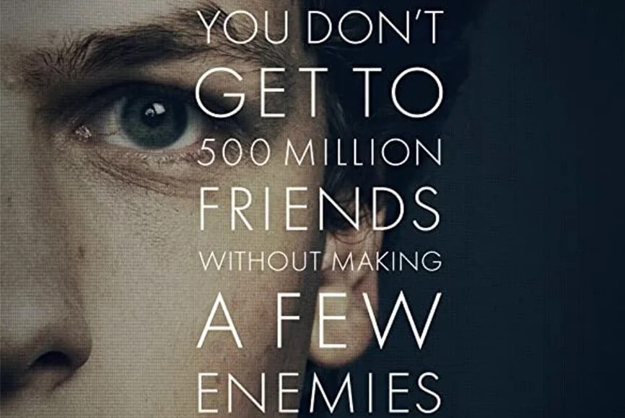
Genre:Biography, Drama
Original Language:English
Director:David Fincher
Producer:Scott Rudin, Dana Brunetti, Michael De Luca, Ceán Chaffin
Writer:Aaron Sorkin
Release Date (Theaters):Oct 1, 2010 Wide Release Date (Streaming):Jun 5, 2012 Box Office (Gross USA):$96.9M
Runtime:2h
In 2003, Harvard undergrad and computer genius Mark Zuckerberg (Jesse Eisenberg) begins work on a new concept that eventually turns into the global social network known as Facebook. Six years later, he is one of the youngest billionaires ever, but Zuckerberg finds that his unprecedented success leads to both personal and legal complications when he ends up on the receiving end of two lawsuits, one involving his former friend (Andrew Garfield). Based on the book "The Accidental Billionaires.”
By Tanishq Chholak, RA2011004010449
THE SOCIAL NETWORK

Slide 11

Revolution 2020
Written by Chetan Bhagat
Character names : Gopal Mishra, Aarti Pradhan, Raghav kashyap Published : 5th October, 2011 Plot This book follows the story of two friends separated by their ambitions and passions yet connected by their love for the same girl, Aarti. While Gopal, who has experienced the harsh realities of life due to poverty aspires to become rich, his friend Raghav is a boy from a well-off family who desires to create a revolution in India by fighting corruption.
Famous quotes
There are two ways of spreading light: to be candle or the mirror that reflects it. Life may not offer you the same chance twice. World is full of nice people,if you cannot find one, be one.
BY Rajveer Naidu
RA2011004010450

Slide 12
Thank You

